Slide 1
Module 4
Lecture 5:
Hidden Markov Models

Slide 2
Hidden Markov Model
Hidden Markov Model (HMM) is a statistical Markov model in which the system being modeled is assumed to be a Markov process with unobserved (i.e. hidden) states.
Hidden Markov models are especially known for their application in reinforcement learning and temporal pattern recognition such as speech, handwriting, gesture recognition, part-of-speech tagging, musical score following, partial discharges and bioinformatics.

Slide 3
Terminology in HMM
The term hidden refers to the first order Markov process behind the observation. Observation refers to the data we know and can observe. Markov process is shown by the interaction between “Rainy” and “Sunny” in the below diagram and each of these are HIDDEN STATES.
Refer the figure in next slide:

Slide 4
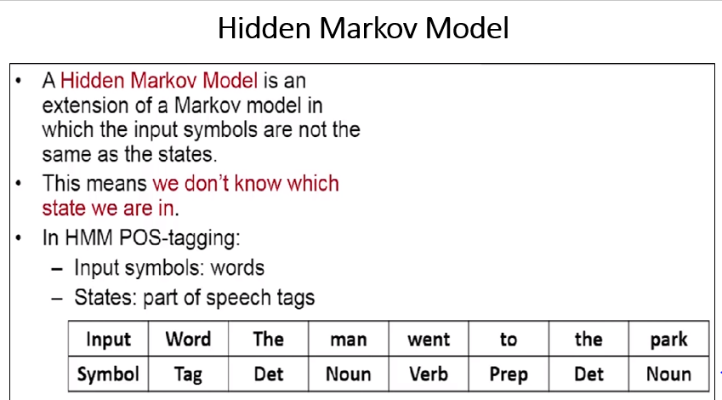

Slide 5
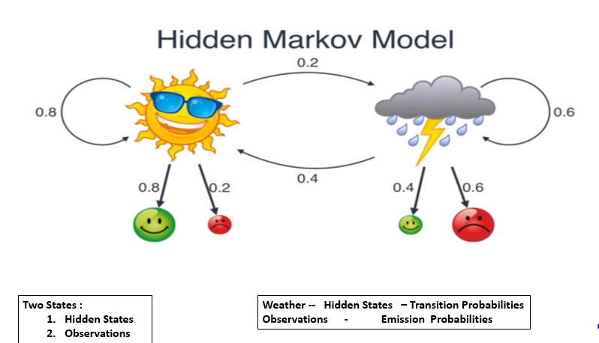

Slide 6
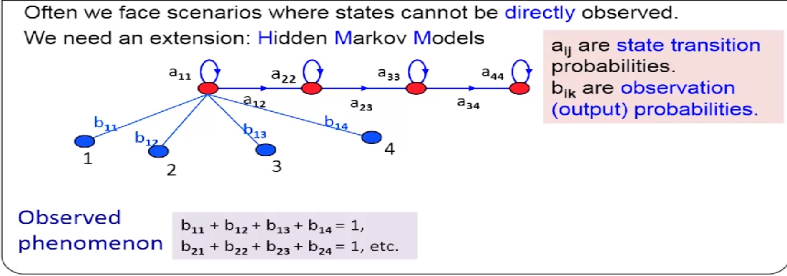

Slide 7
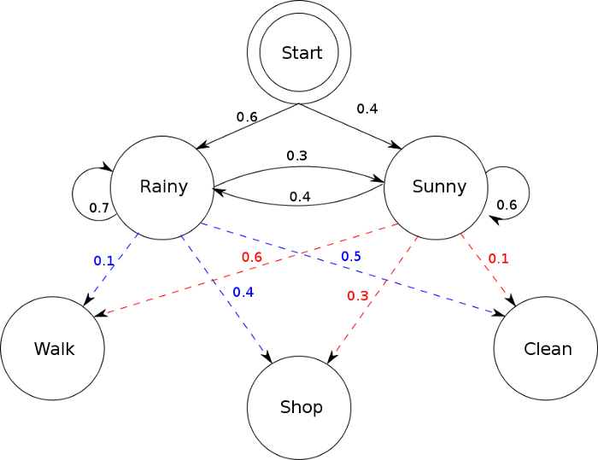

Slide 8
OBSERVATIONS are known data and refers to “Walk”, “Shop”, and “Clean” in the above diagram. In machine learning sense, observation is our training data, and the number of hidden states is our hyper parameter for our model. Evaluation of the model will be discussed later.

Slide 9
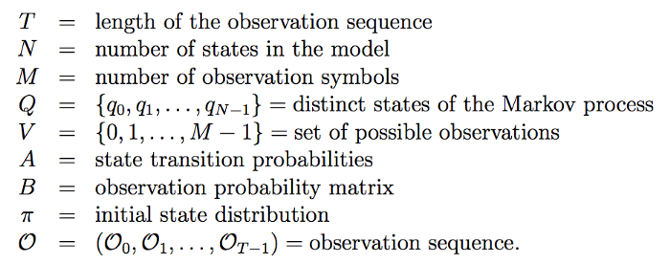

Slide 10
T = don’t have any observation yet, N = 2, M = 3, Q = {“Rainy”, “Sunny”}, V = {“Walk”, “Shop”, “Clean”} State transition probabilities are the arrows pointing to each hidden state. Observation probability matrix are the blue and red arrows pointing to each observations from each hidden state. The matrix are row stochastic meaning the rows add up to 1.

Slide 11
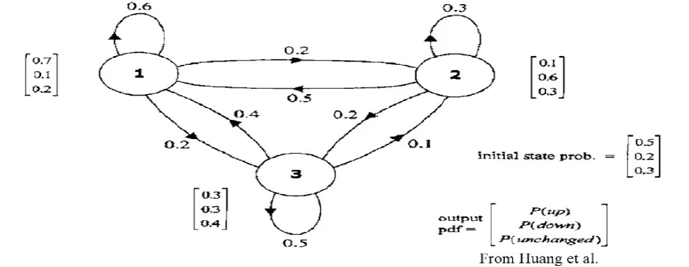

Slide 12
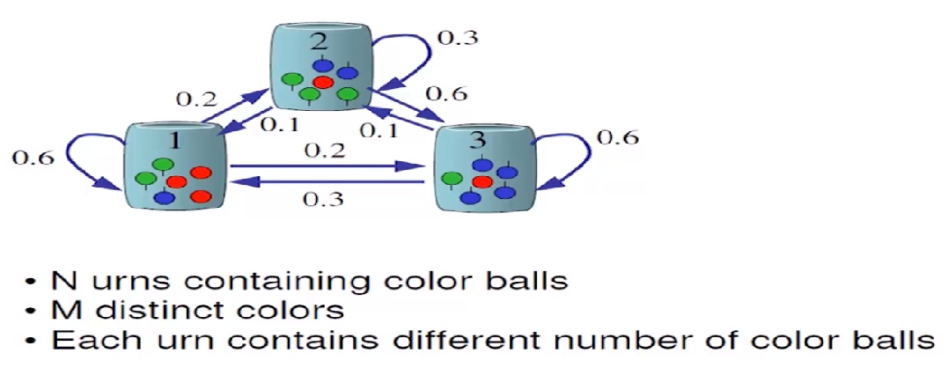

Slide 13
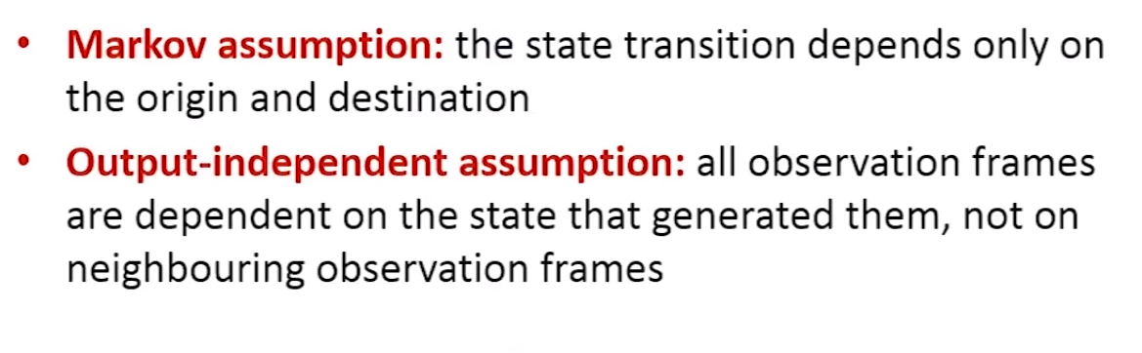
HMM : Assumptions

Slide 14
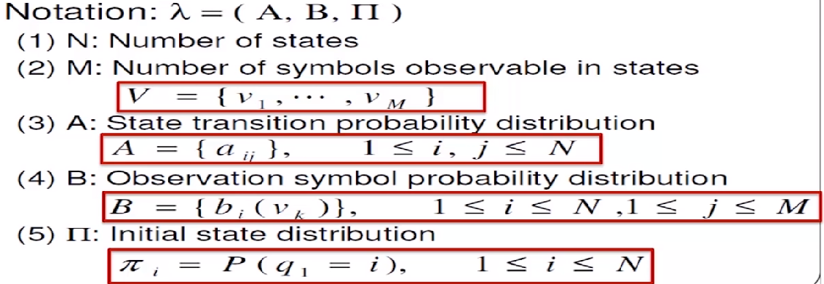
HMM : Definition

Slide 15
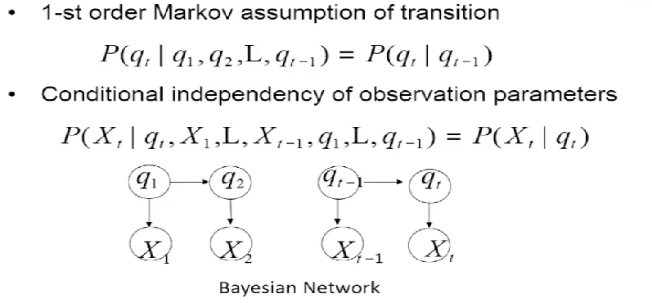
HMM : Dependency Structure

Slide 16
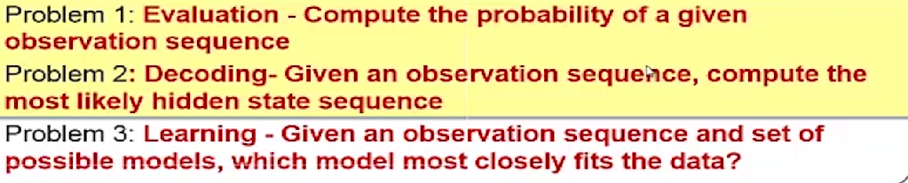
Problems in HMM

Slide 17
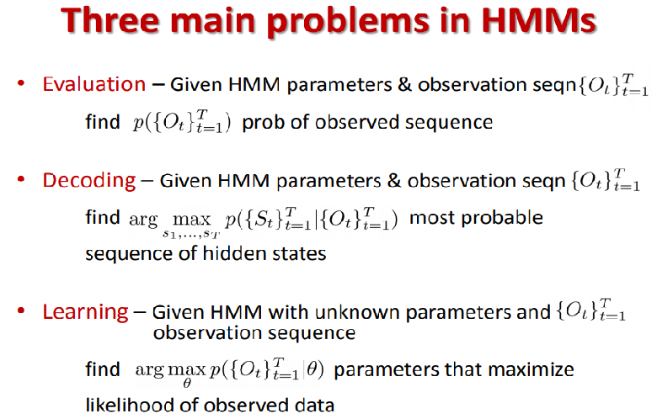

Slide 18
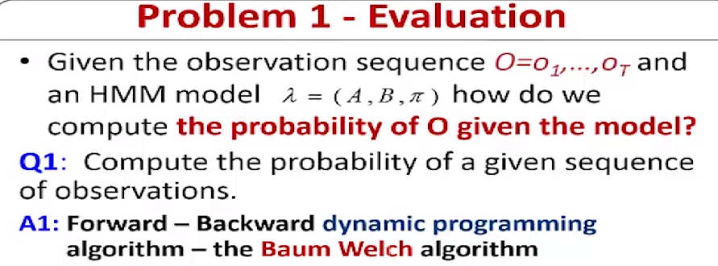

Slide 19
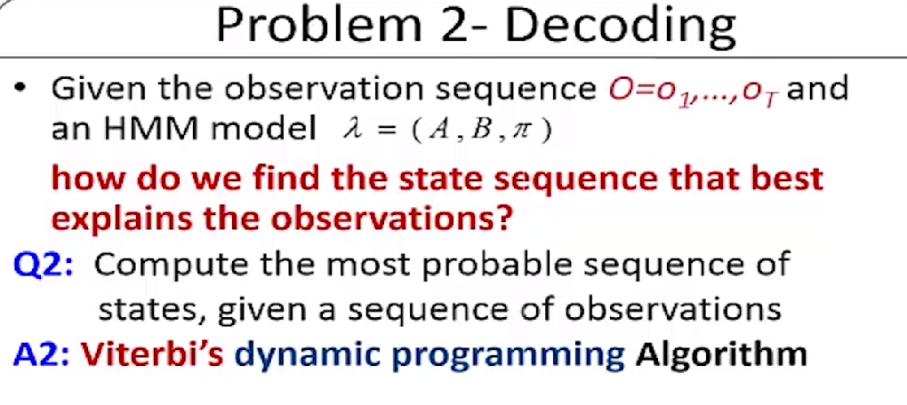

Slide 20
